Slide 1
Machine Learning

Slide 2
What is machine Learning?
Machine learning is the field of study that gives the computer the ability to learn without being explicitly programmed.
-Arthur Samuel

Slide 3
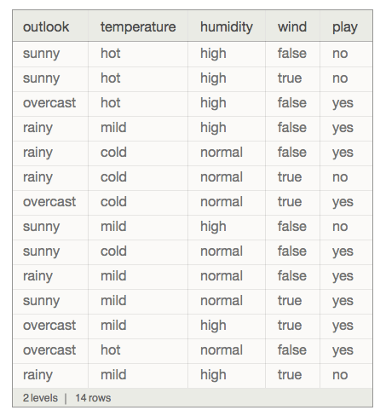
What is a dataset?
A collection of data is called dataset.
It is mostly in the form of text and images.

Slide 4
Preprocessing - IMPUTING
The dataset should not contain any missing values, The missing values in dataset should be processed in order to proceed further.
Class | Group 1 | Group 2
Class 1 | 82 | 95
Class 2 |  | 88
Class 3 | 84

Slide 5

Replacing The Missing Values
Mean
Median
Most Frequent

Slide 6
Processing Categorical Data
Country(Categorical) | Country(Numerical)
GERMANY | 1
FRANCE | 0
ITALY | 2
Mathematical algorithms will not work under categorical data. They must be encoded into some numerical form to proceed further.

Slide 7
TYPES of Machine learning
Supervised Learning.
Unsupervised Learning.
Semi supervised Learning.
Reinforcement Learning.

Slide 8
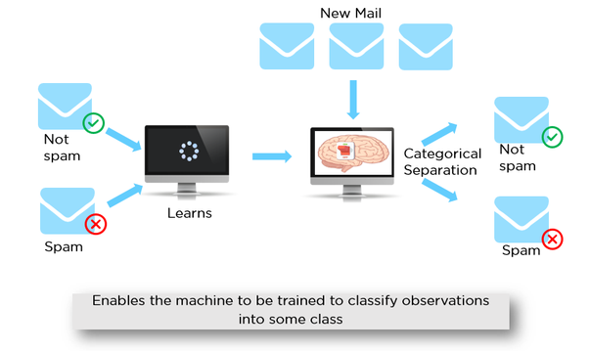
Supervised Machine Learning
In supervised machine learning the training data will contain desired outputs. A typical example would be a spam filter.

Slide 9
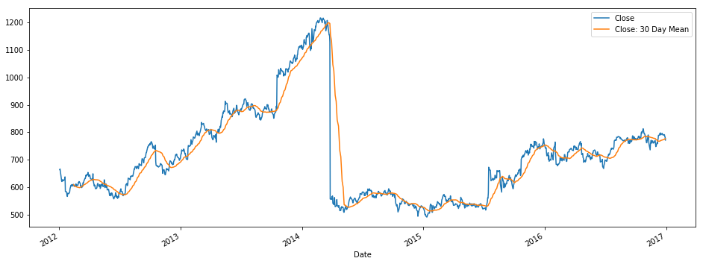
Regression
Regression is used to forecast future values from the training dataset.
Example whether forecast, share market prediction etc.,

Slide 10
Simple linear regression
Simple linear regression has one independent variable and one dependent variable. X and y.
Y = b0 + b1 * X1
Y => Dependent Variable.
X => Independent Variable.
B0 => Constant.
B1 => Coefficient of the independent variable.

Slide 11
Multiple linear regression
Is same as simple linear regression but it has many independent variables.
y = b0 + b1x1 + b2x2 + … + bnxn

